Slide 1
STRATEGY PROOFNESS IN LARGE MATCHING
For
Algorithmic Game Theory (CS60025)
By
Rajdeep Das (20NA30021)
Sayak Roy (22CS60R04)
Rinkesh Kumar Meena (20EE10061)

Slide 2
Contents
INTRODUCTION
THEORY
METHODOLOGY: PREFERENCE GENERATION
METHODOLOGY: DEFERRED ACCEPTANCE
METHODOLOGY: COUNTING DEVIATIONS
RESULTS
DISCUSSIONS
CONCLUSION

Slide 3
INTRODUCTION
In large matching markets there are often a small fraction of agents who may advantageously deviate
Here we discuss how approximate strategy proofness makes the matching algorithm more robust in large markets
We can conduct several simulations to see when we may approximate our strategy proofness
We can gain insights for what market size, length of preference lits and preference correlation it looks effective to a lower extent

Slide 4
THEORY
We will base our study on the following existing theories:
In two-sided matching, deferred acceptance returns a stable matching and in general, there exists useful deviations only for the agents that are being proposed to with the proposing side having truthful reporting as the dominant strategy
In simple markets, all successful manipulations can also be accomplished by truncations. Instead of searching for k! Possible permutations of preferences, it is sufficient for preference orders of length k to truncate the preference order once at each location for each participant on the receiving side.

Slide 5
METHODOLOGY: PREFERENCE GENERATION
Here, we attempt to realistically model agent preferences in a way that resembles the distribution of preferences in real market
The distribution is defined by inverse of exponential function
We model 3 different scenarios based on correlation
Almost no correlation
Moderate correlation
High correlation
The preference order was generated based on these distributions

Slide 6
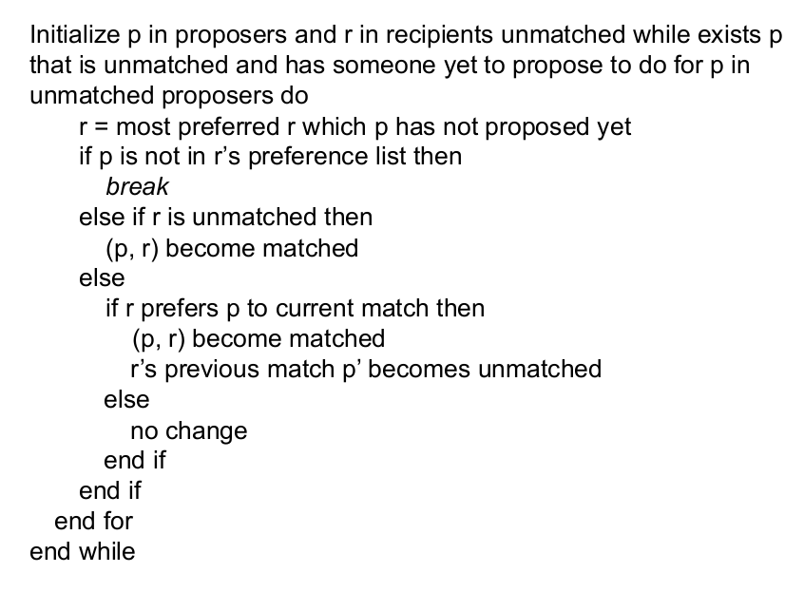
METHODOLOGY: DEFERRED ACCEPTANCE
We used postponed acceptance approach which is known for creating stable matches.
The following is the pseudocode for the given approach

Slide 7
METHODOLOGY: COUNTING DEVIATIONS
We establish a relationship between D(n), I.e., the number of agents with meaningful deviations and n I.e., the number of agents on one side of market
We established that the only way for helpful deviations is reporting in the form of truncation deviation by the receiving side
Hence for every female, we truncate their last preference entry in order and run deferred acceptance to check if they benefit or not.
We can count the total number of beneficial deviations in this way.

Slide 8
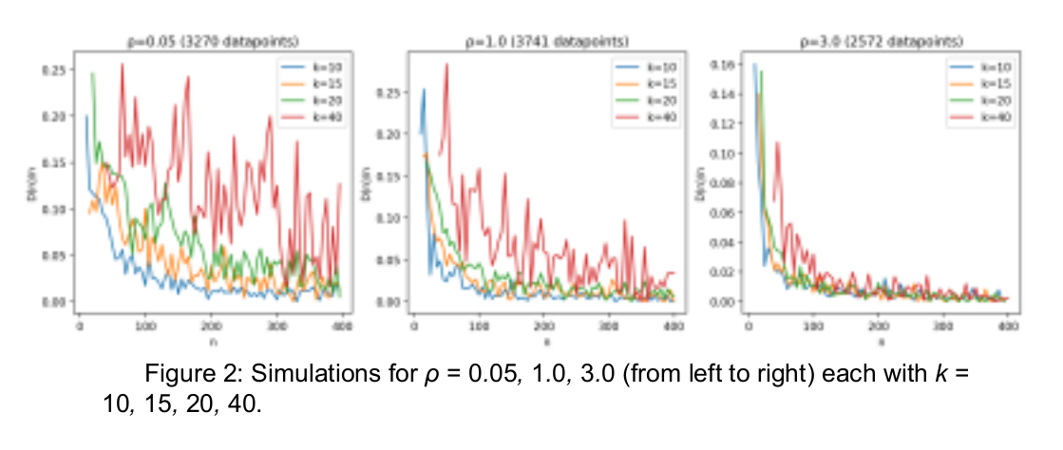
RESULTS

Slide 9
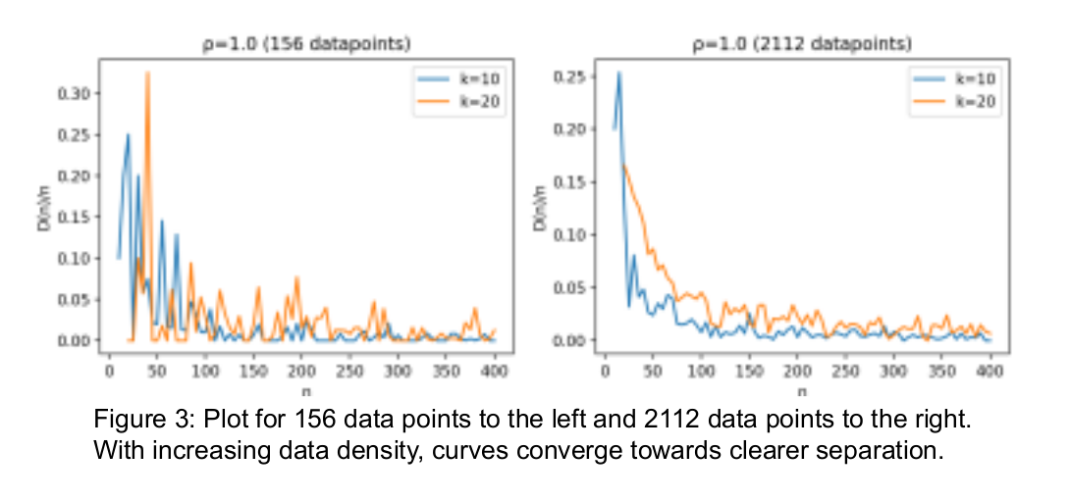
RESULTS

Slide 10
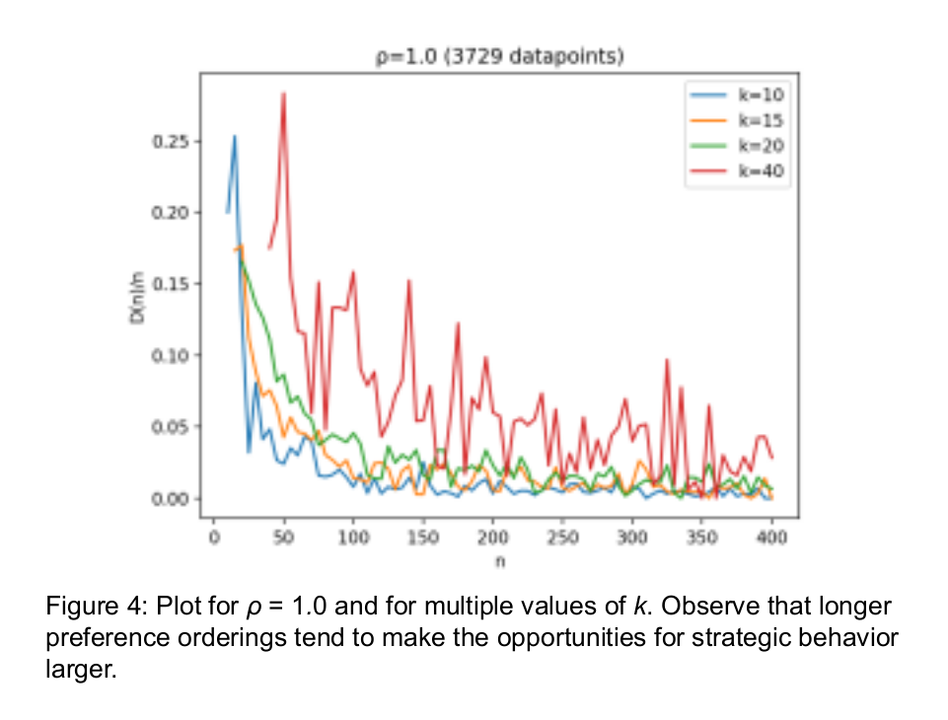
RESULTS​

Slide 11
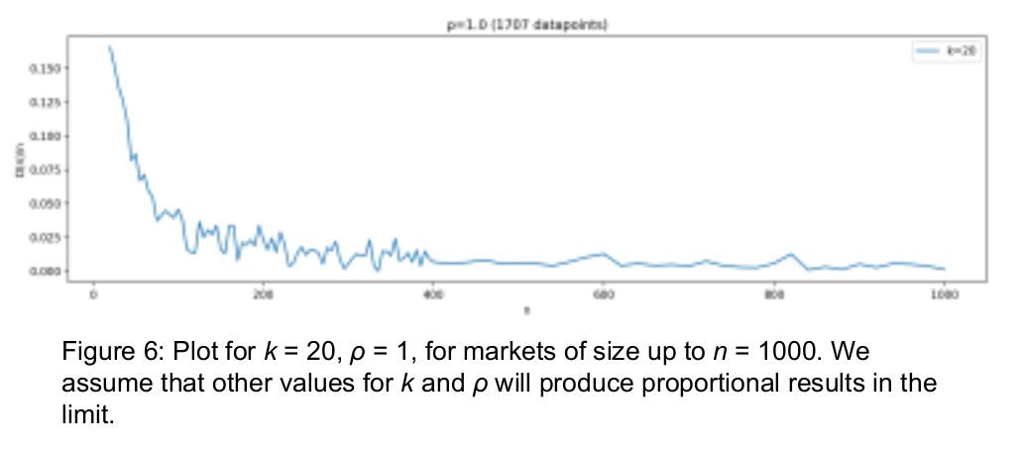
RESULTS

Slide 12
DISCUSSIONS
Effect of Varying Preference-Order Length
in general, the plots of D(n)/n for a given n increases with k. Intuitively this makes sense as a larger k quite simply gives more preferences to truncate away, i.e., more possible deviations.
Effect of Varying the Preference Correlation
We note that an increase in correlation leads to a smaller ratio of agents who can fully deviate D(n)/n. As for the reason, having more agents interested in the same matches makes the rejection chain shorter, thus making it unlikely to return to the deviator.

Slide 13
CONCLUSION
We discovered that near strategy-proofness is common in large marketplaces.
According to our models, the fraction of agents with relevant deviations declines the most rapidly between market sizes of 10 and 100.
The approximate strategy-proofness decreases with preference order length and increases with preference correlation.

Slide 14
THANK YOU

